Slide 1


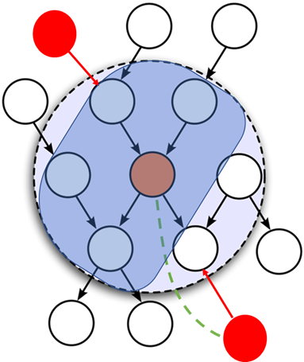
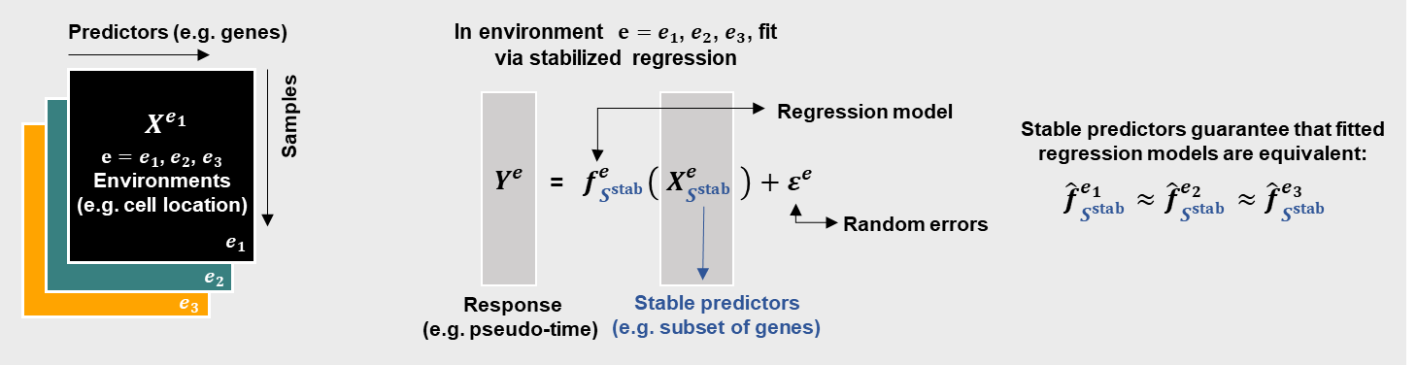
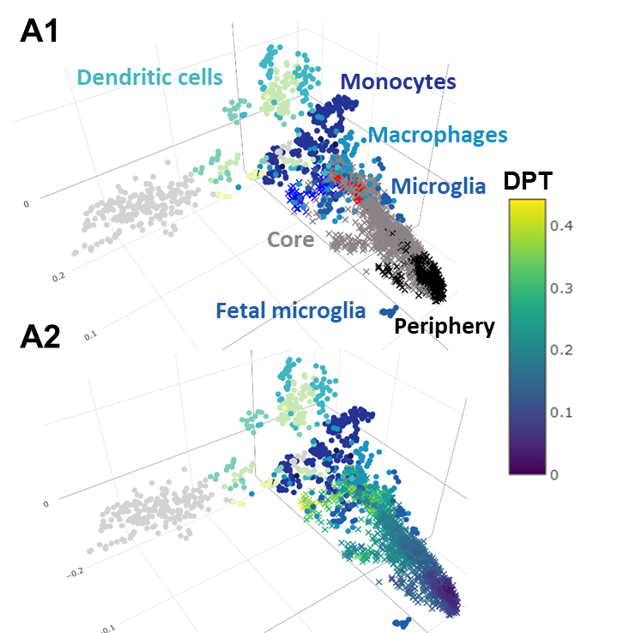
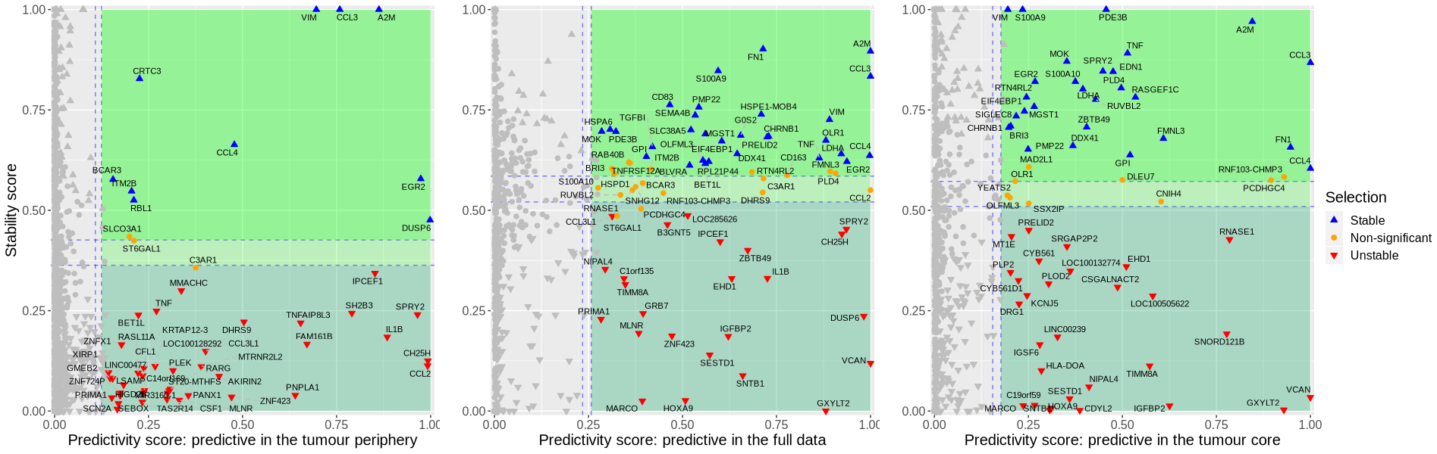
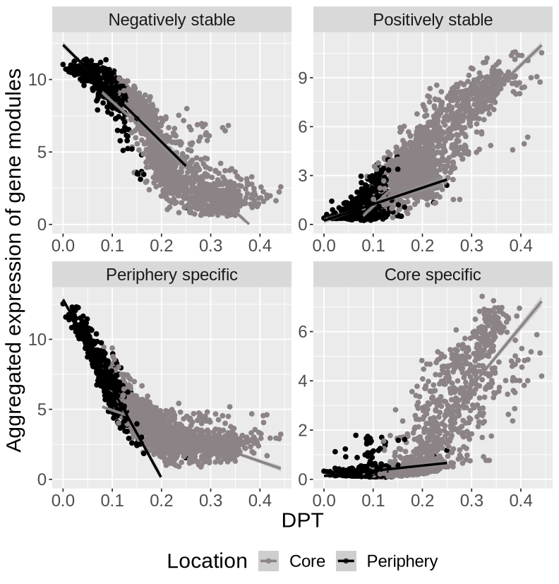
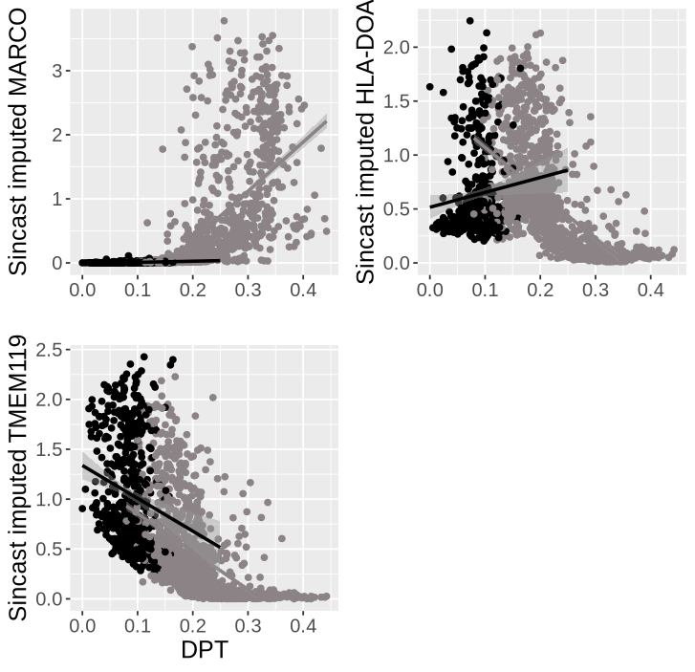
StableMate: a new statistical method to select stable predictors in omics data
A case study of characterising cell identity transition of glioblastoma tumour-infiltrating microglia with scRNA-seq data
Yidi Deng^{1,2}, Jiadong Mao¹, Jarny Choi^{2,†,&}, Kim-Anh Lˆe Cao^{1,*,&}
1 Melbourne Integrative Genomics, School of Mathematics and Statistics, The University of Melbourne, Australia
2 Department of Anatomy and Physiology, Faculty of Medicine, Dentistry and Health Sciences, The University of Melbourne & Bioinformatics and Cellular Genomics, St Vincent’s Institute, Australia
Highlight
Link between Stability & Causality
We developed StableMate¹, a statistical approach which identifies statistical associations that are environment-specific or –agnostic and stable.
Environment refers to a biological condition or an experiment from which samples are collected.
We applied StableMate to a scRNA-seq dataset from Darmanis et al. (2017), who sequenced myeloid cells from the core and the periphery of Glioblastoma (GBM).
We first characterized cell trajectory between the two locations, core and periphery.
Our StableMate analysis revealed transcriptional activities of microglia that are consistently seen or specific to the two locations during its transition to tumour associated microglia.
Stable associations are approximately causal
Environment perturbation
predictors
(In a regression setting, conditioning on stable predictors, response and environment perturbation are independent )
response
Method
--
We improved a stochastic selector: stochastic stepwise (ST2²) variable selection to select genes.
Run ST2 for K times to select highly predictive genes.
Within each selected predictive gene set, run ST2 for K times to select for stable genes.
Calculate importance scores of predictive genes based on weighted average of selection.
Build a regression ensemble based on the selection ensemble
Stable associations: functional dependencies that are consistent across cell locations
Data
Stability analysis
Sincast projection³ of the query, reveals a transition from microglia to macrophage and monocytes
Predictive in one location but unstable (labeled red) suggests transcriptional activity specific to a location
Major patterns
Core-specific M2 TAM markers
Conclusion
Negatively Stable:
CCL3,CCL4,EGR2,CD83 signify pre-activation
StableMate make biological insights that cannot be done by traditional statistical analysis (e.g, co-expression analysis).
Periphery myeloid cells were primarily microglia undergoing polarisation.
Pro-inflammatory microglia seem to transiently exist at the start of the core-stage of the transition and were rapidly reprogrammed into M2-like TAM.
Microglia pre-activation markers seem to active consistently in both locations regardless of the pressure from tumour microenvironment.
StableMate can be applied to wide range of biological data types and questions as demonstrated in our two other case studies.
Periphery specific:
TNF,CCL2,CSF1,
IL1B signify polarisation
The development of MARCO+; MHC-II-; TMEM119- phenotype suggests a transition from microglia to TAM
Core specific:
VCAN, GXYLT2
signify the development of TME
References
Deng et al. 2023 "StableMate: a new statistical method to select stable predictors in omics data." bioRxiv
Deng et al. 2022 "Sincast: a computational framework to predict cell identities in single-cell transcriptomes using bulk atlases as references." Briefings in Bioinformatics 23.3
Xin et al. 2012 "Stochastic stepwise ensembles for variable selection." J oComp and Graphical Stat 21.2
E: yidid@student.unimelb.edu.au
Github: https://github.com/meiosis97
Funding
ARC DP200102903, NHMRC Career Development fellowship GNT1159458 (KALC) and the Melbourne Research Scholarship YD).
Notes:
The genes we selected revealed that the periphery myeloid cells were primarily pre-activated microglia undergoing polarisation. The pro-inflammatory microglia transiently exist at the start of the core-stage of the transition and were rapidly reprogrammed into M2-like immunosuppressive TAM. The location-agnostic genes were represented microglia pre-activation markers, which could active consistently in both locations regardless of the pressure from tumour microenvironment.

